Slide 1
Intro to TDD

Slide 2
Test-Driven Development

Slide 3
TDD is testing, but more
TDD is a set of practices
Has benefits beyond what other forms of testing provide
Test-first programming
But more than that
The PROs and CONs are in addition to those for testing in general
Notes:
TDD adds a more rigorous PROCESS for writing tests. Other than this process, everything you know about testing still holds true.

Slide 4
Agenda
PROs (Why)
CONs (Challenges)
How
Misc
Next steps
Questions
Notes:
Feel free to jump in at any time to ask questions.

Slide 5
PROs

Slide 6
Documentation
Tests written via TDD document what the code SHOULD do
Traditional tests are often based on what the code HAPPENS to do
Notes:
We don’t need to ask permission to do the right thing

Slide 7
Design
The TDD process improves our code’s design
Writing code that USES your code first will force you to think from the USER’s perspective
Separates interface design from implementation
Leap of faith
Constraints
Notes:
Leap of faith == let’s treat it as an experiment.
Constraints - creative limitation is the concept of purposely limiting oneself to drive creativity.

Slide 8
Confidence
Tests give us confidence that we’re not making any regressions
TDD adds more confidence
Because we know the tests are better at matching the specifications

Slide 9
Four rules of simple design
Passes the tests
Reveals intention
No duplication
Fewest elements
Notes:
The 4 rules of simple design help guide us to write good maintainable code.
Note that these are listed in order of importance: passing the tests is the most important. Revealing intention is to ensure that the code is easily readable; it primarily involves choosing good names. No duplication and fewest elements tell us that we need to refactor in order to have maintainable code.

Slide 10
Focus
Keeps you focused on smaller steps
Agile
Fast feedback loops
Smaller steps
Easier to make progress (usually)
Easier to refactor
Notes:
One of the reasons I prefer TDD is that it helps keep me focused. It’s easier to focus on something smaller than something complex that involves many pieces.
TDD is an Agile practice, encouraging faster feedback loops. Fast feedback helps us determine if we’re heading in the right direction at all times.

Slide 11
Less code
“Done” is more well-defined
Tests pass
And no more tests need to be written
Only write code that’s required to pass the tests
Seeing a test fail before writing the code proves that you HAD TO write that code
Refactoring will ensure that the code you had to write isn’t bad
Every piece of code will only exist because a test required it
Less temptation to spend time making things overly abstract
Notes:
I like that TDD keeps me from writing more code than I need to. I know when I’m finished making the code do what I want it to.

Slide 12
Testable = usable
TDD will force you to write code that is easily tested
Code that is easy to test is also easier to use
Smaller pieces
Better abstractions
More modular design
More reuse
Reduced coupling
Notes:
When you write the tests first, you’re thinking about USING the production code BEFORE you even write it. This leads to code that’s more usable.

Slide 13
Understanding
TDD helps developers better understand the requirements
Tests are requirements written in code
More concrete
Easier to see the link from feature requirements to code
Notes:
Ideally, a given test can easily be traced back to the requirements. Some teams put a (Jira/Rally) story number with every test (in a comment, usually). Other teams do that only for tests that are associated with a bug.

Slide 14
Debugging
TDD will reduce the time you spend debugging
Notes:
You’re more likely to catch mistakes as soon as you make them when doing TDD. Another benefit of the short feedback loop.

Slide 15
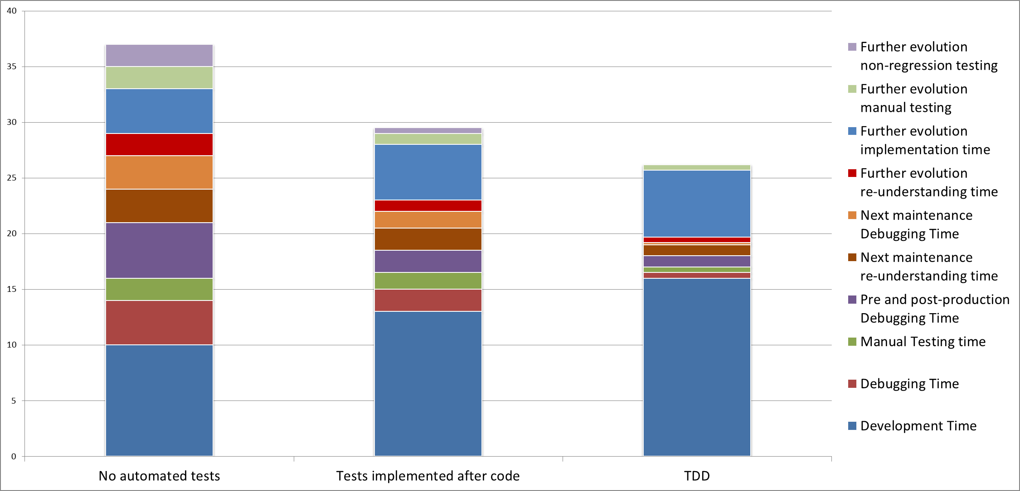
TDD will reduce TCO
Notes:
Here’s a chart showing the time spent on various development activities, comparing TDD with test-after and having no tests.
Notice that development time does go up some, but it’s made up by reducing time spent debugging and maintaining the code.

Slide 16
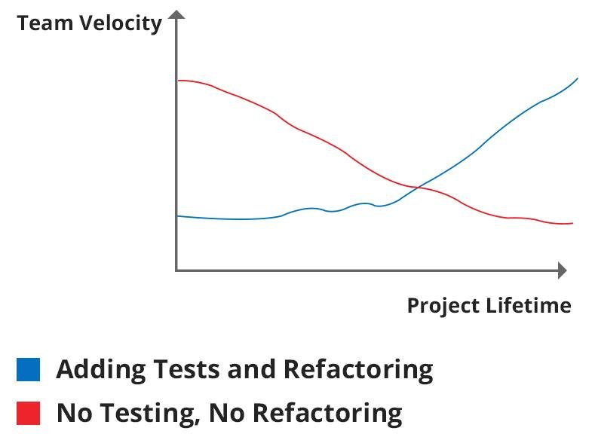
Long-term v short-term
Notes:
Here’s another way to see that TDD wins in the long-term, but has a cost to get started.

Slide 17
CONs
Notes:
TDD doesn’t ALWAYS work out.

Slide 18
Exploration
Sometimes we don’t know what we NEED
Can’t write a test until we figure out what we need
And express it in test code
Spike
Experiment with code
We SHOULD throw this code away and do TDD
Notes:
If we don’t know what we need, we can do a spike to figure it out.
You’re SUPPOSED to throw away the code that you come up with in a spike, but few teams actually do that. I like to comment out the new code, write the tests, and copy pieces of the code over as needed to pass the tests.

Slide 19
Difficulty
Sometimes we don’t know HOW to write a test for what we need
Hard to learn
Will slow us down in the short term
We have management’s buy-in on this
Notes:
It can be hard to figure out how to write tests for some things. This is especially the case when there are a lot of dependencies. But that could also be a “test smell” telling us that we have too many dependencies.

Slide 20
Discipline
It’s hard to build discipline to write tests first
Notes:
It’s also hard to STAY disciplined.
Practice makes permanent.

Slide 21
Leap of faith
It will take a leap of faith to get started
We will slow down as we learn TDD
Management is aware of this
They know that it will pay off in the long run
Trust the process
Notes:
I don’t think I’ve ever seen a team fail to get decent at TDD.
We all have trouble staying disciplined over time – it’s a hard habit to make/keep.

Slide 22
HOW
The process

Slide 23
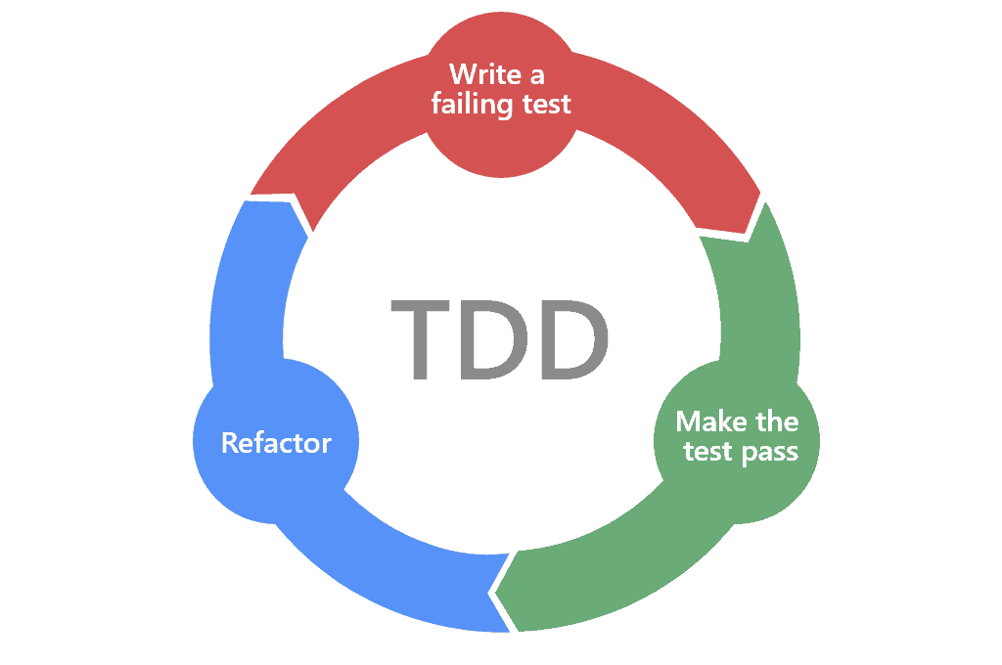
Red, Green, Refactor
Notes:
This is the process. We start by writing a failing test. Seeing the test fail is important; if the test passes before we write any code, then we don’t need any new code, and thus should not write any new code. Either that, or we’re not really testing what we think we are.
Separating the refactoring step lets us get to “green” more quickly. You can even copy and paste code to get to “green” quickly, knowing that you’ll clean it up right away. Once we’ve refactored (if necessary) we ensure that all the tests still pass, and then start they cycle over with the next test.

Slide 24
Laws of TDD
You are not allowed to write any production code unless it is to make a failing unit test pass.
You are not allowed to write any more of a unit test than is sufficient to fail; and compilation failures are failures.
You are not allowed to write any more production code than is sufficient to pass the one failing unit test.
Notes:
These come from “Uncle Bob”.
Second step example: adding a line of test to reference a class that doesn’t exist yet would count as a failure. You’d then write just the code to create the class.
Last step: you really need to trust the process on this one. If it’s important enough to be in the code, it’s important enough to be tested.

Slide 25
Laws of TDD – simple version
Write production code only to make a failing unit test pass.
Write only enough of a unit test to fail.
Write only enough production code to make the failing unit test pass.
Notes:
Here’s a simpler way to state the 3 laws, from https://www.javiersaldana.com/articles/tech/refactoring-the-three-laws-of-tdd

Slide 26
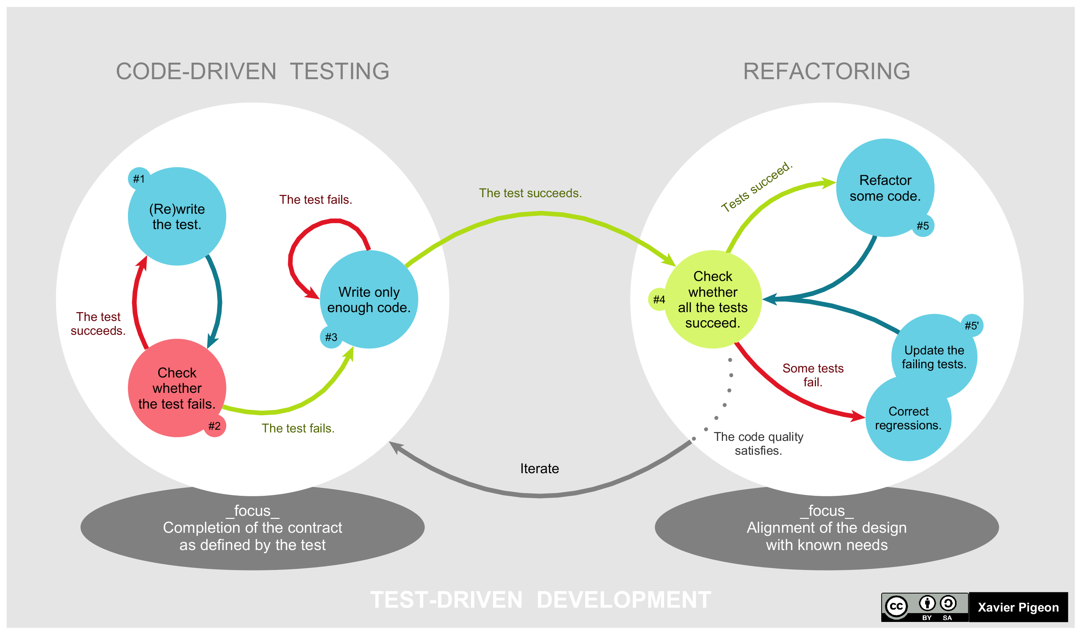
The Process
Notes:
Here’s a more complex flow chart of the process. (Note that the steps are numbered – start with #1.)

Slide 27
Misc.

Slide 28

Book
Notes:
This is the canonical book on TDD, written by Kent Beck, who came up with TDD. (Although he says that he merely rediscovered it from a book written several decades earlier.)

Slide 29
Further reading
The Cycles of TDD
Simple example of TDD
Notes:
Cycles of TDD (Uncle Bob Martin) talks about the iterative processes from seconds to minutes to hours to days.
Simple example has some code in C# demonstrating the minimal changes for each step - including only writing a class to make the code compile.

Slide 30
Summary
TDD is simple
TDD is difficult
TDD is worth the effort in the long run

Slide 31
Next steps
Find opportunities to try TDD
Lesson(s)
Examples
Code katas
Your requests
Practice
Feedback
Let me know what you find difficult

Slide 32
Questions
Notes:
I'll try to answer here, but may need to take notes to answer in a later session.

